Slide 1
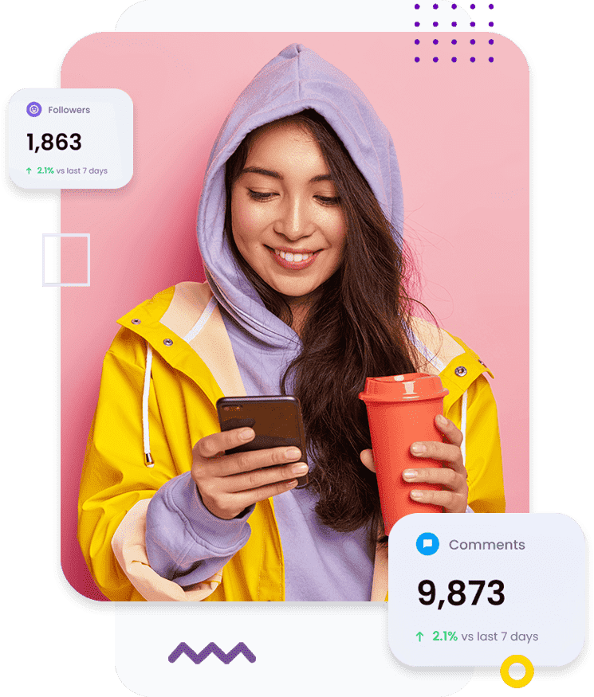
Come Online With Your Own Profile Website
Brand Yourself Now

Slide 2
Your Unique URL Website
Website You Can Update
Responsive Website / Multi Design
HTTPS SSL Website Secure
List Your All Services
List Your Products and deals
Instant Get Leads in WhatsApp
Free Listing and Digital Marketing
Clients Feedback Capture & Publish
Interact With other Professionals
Business oriented Platform and Income
MyProfile365 Internal Application

Slide 3
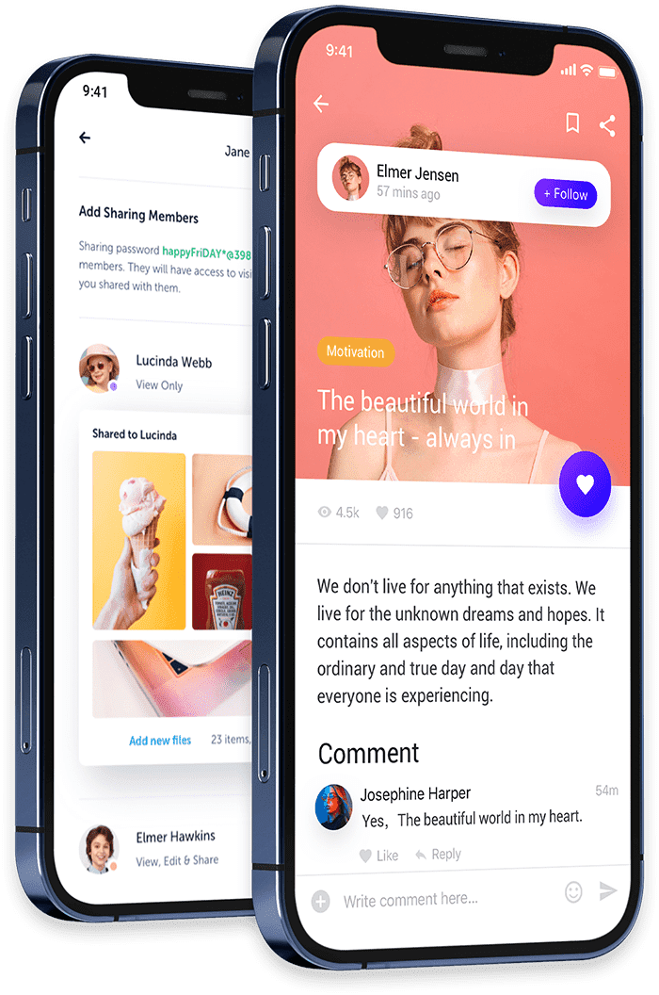
PRICING & COST
Rs 639
Every Month Renewal Same Rs 639
Remember tax is included in Rs 639

Slide 4
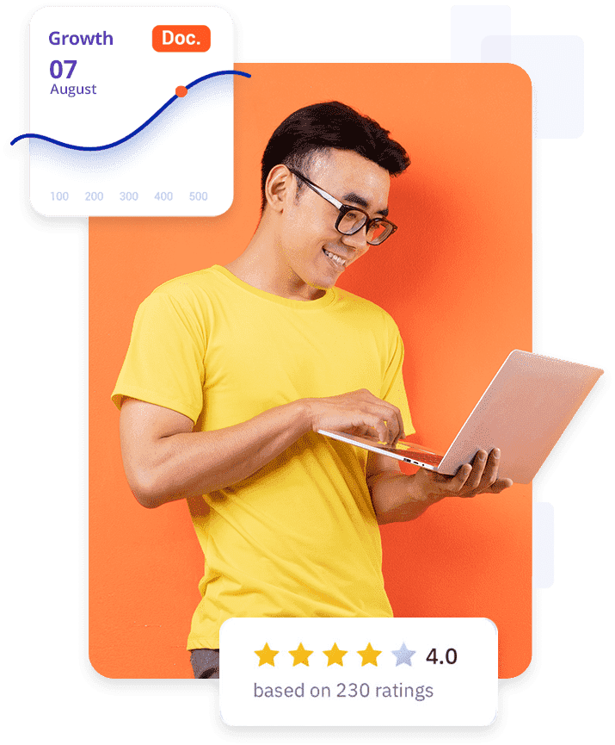
Business Plan
There is Unique Business Plan if you Refer Clients
Team Commission-Running Personal Wallet
L1 Sponsors Bonus Monthly : Rs 50
L2 Sponsors Bonus Monthly : Rs 40
L3 Sponsors Bonus Monthly : Rs 40
L4 Sponsors Bonus Monthly : Rs 150

Slide 5
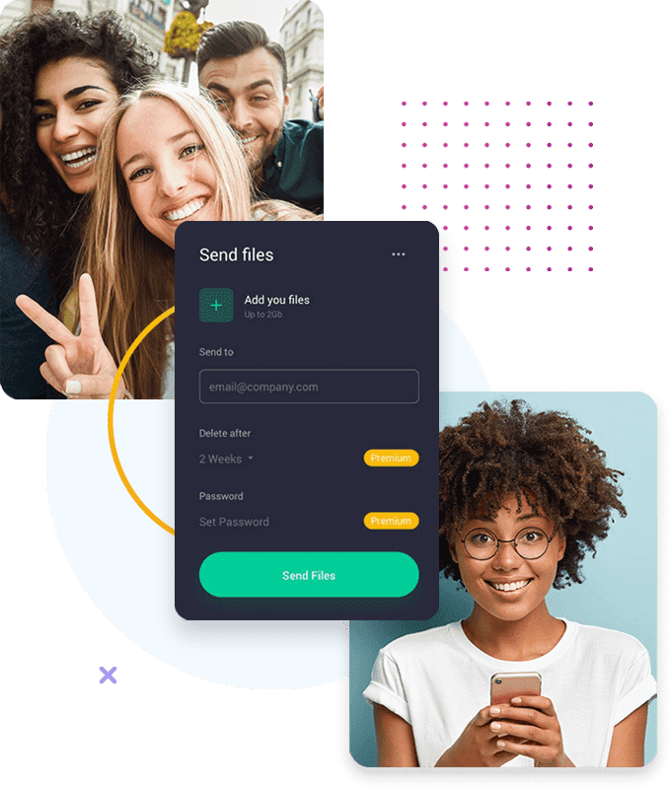
Team Commission
4 Levels Commission from your referred clients and friends Monthly.
Direct : Rs 50 : 5 Reference Needed
Level 2 : Rs 40 : 25 Reference Needed
Level 3 : Rs 40 : 125 Reference Needed
Level 4 : Rs 150 : 625 Reference Needed

Slide 6
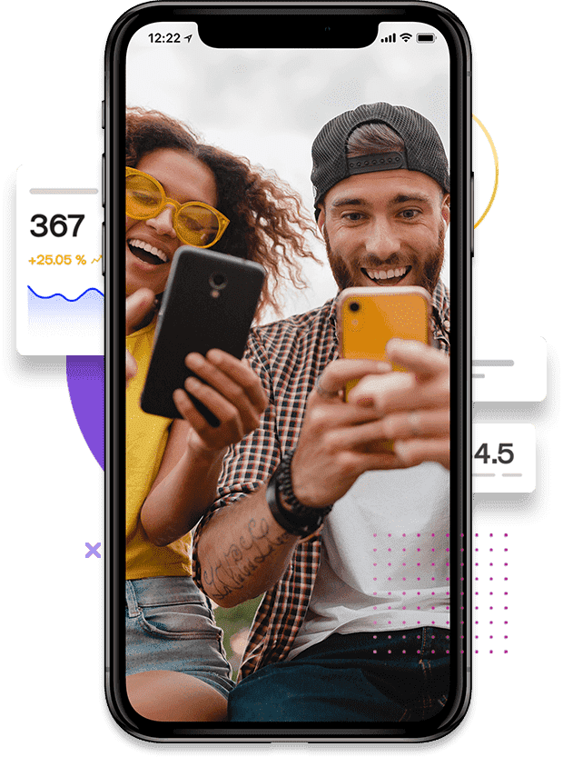
MONTHLY AUTO
Can Not Refer More Than 5 Users. Your referred user automatic go under your reference choice
LEVELS | CLIENTS | AMOUNT | TOTAL
Level-1 | 5 | Rs 50 | Rs 250
Level-2 | 25 | Rs 40 | Rs 1000
Level-3 | 125 | Rs 40 | Rs 5000
Level-4 | 625 | Rs 150 | Rs 93750
TOTAL | 780 | Rs 280 | Rs 1,00,000

Slide 7
LEVEL ACHIEVEMENT
EXAMPLE
Level-1 You get Directly
To Get Level-2 Income, Level-1 Should Have 5 Clients
To Get Level-3 Income, Level-2 Should Have 25 Clients
To Get Level-4 Income, Level-3 Should Have 125 Clients
Note : Need to refer 5 clients First

Slide 8
Become VIP Client
EXAMPLE
Once You refer 5 Clients You become VIP Client
Once a VIP Client Can Play our Daily VIP Games
Can WIN Every Day
Note : Need to refer 5 clients

Slide 9
VIP Game
VIP Games For VIP Users
- Game1 : 10AM to 12PM : 250 Winners
- Game2 : 1PM to 3PM : 250 Winners
- Game3 : 4PM to 6PM : 250 Winners
- Game4 : 7PM to 9PM : 250 Winners
- Game2 : 10PM to 12AM : 10 Winners
Note : Need to refer 5 clients
There is entry fees for each game minimum Rs 100
Games based on Terms and Condition
All Lost amount return to Game Wallet 10% Monthly

Slide 10
Thank You
Get Your Personal Website Today
+91 7749815429
534 A, Esplanade One
Rasulgarh, Bhubaneswar
Odisha, India
https://myprofile365.com/

